Slide 1
PIZZA SALES ANALYSIS In this project I did a comprehensive analysis of pizza sales from a particular outlet over a period of time using RDBMS tool MySql. I used commands like joins, sub-queries, group by, partition by, functions and many more. For this project I solved 3 categories of question: Basic, Intermediate and Advanced. I wrote queries according to different questions in MySql, I am sharing the queries and the results in this presentation.

Slide 2
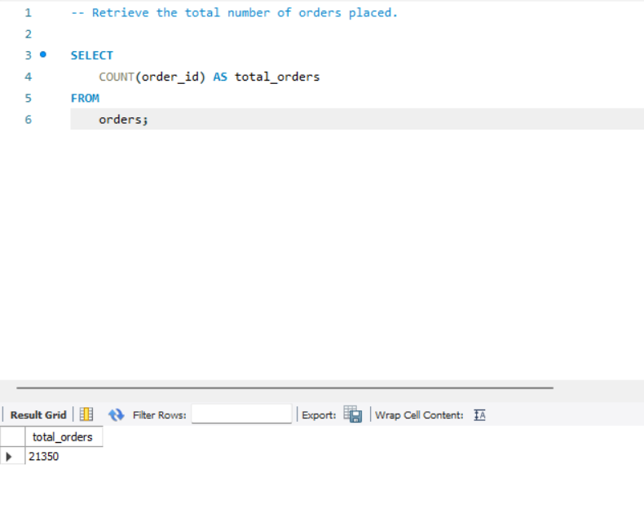

Slide 3
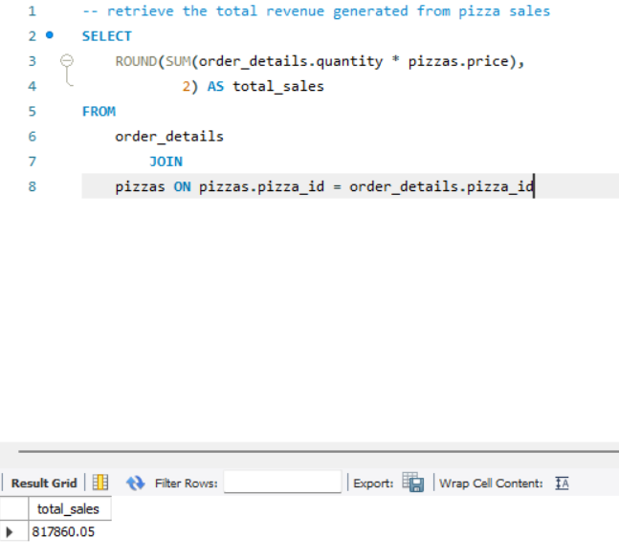

Slide 4
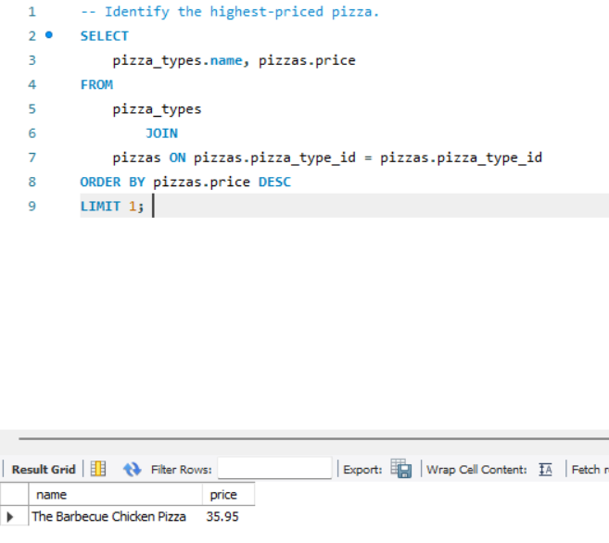

Slide 5
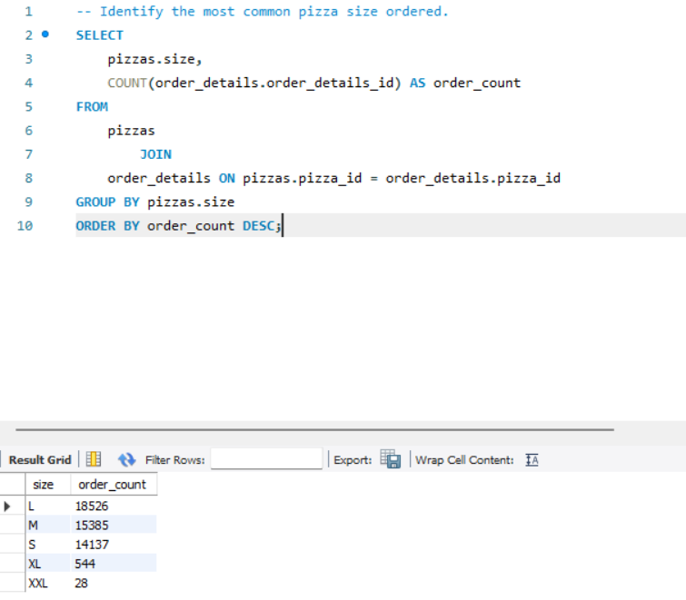

Slide 6
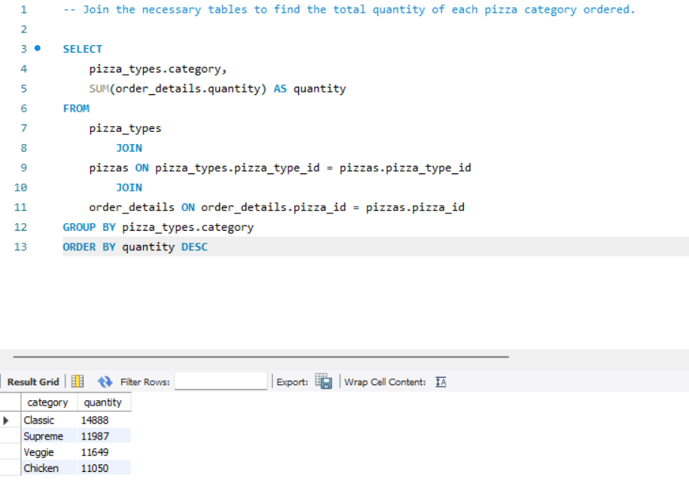

Slide 7
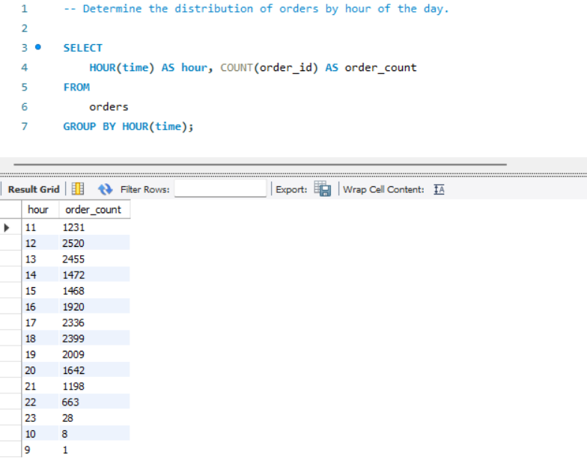

Slide 8
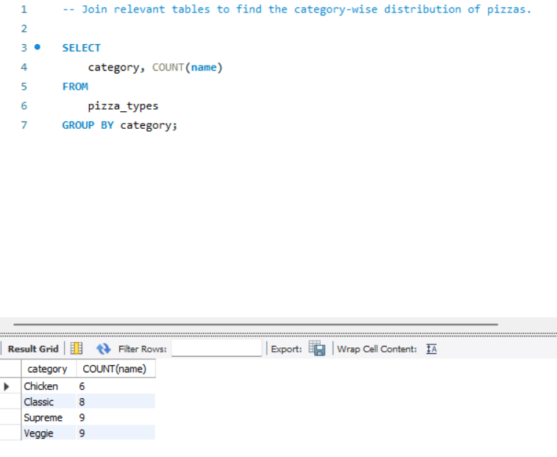

Slide 9
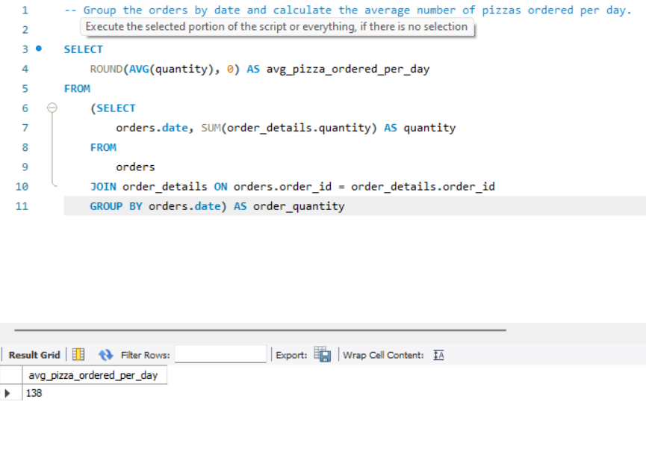

Slide 10
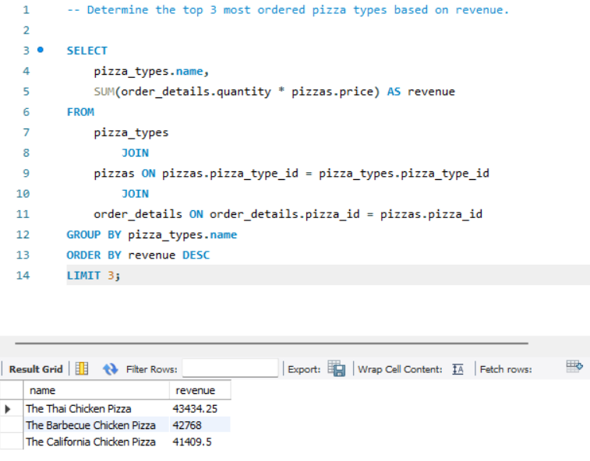

Slide 11
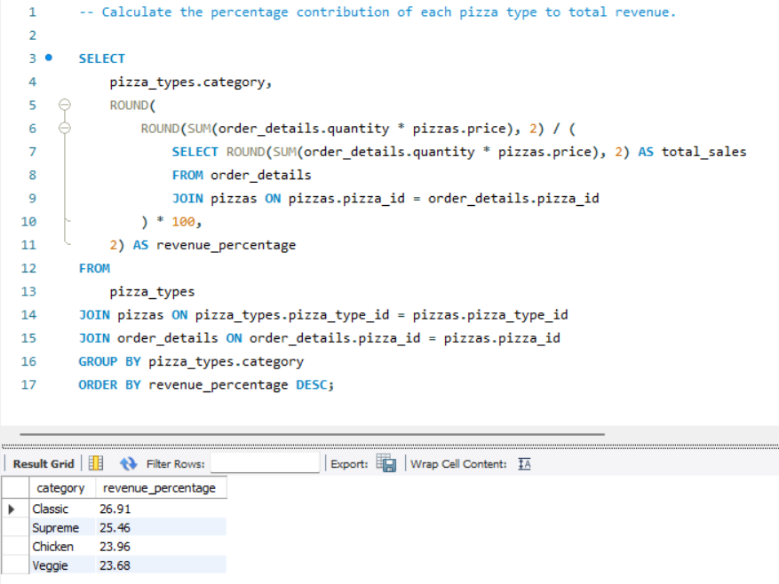

Slide 12
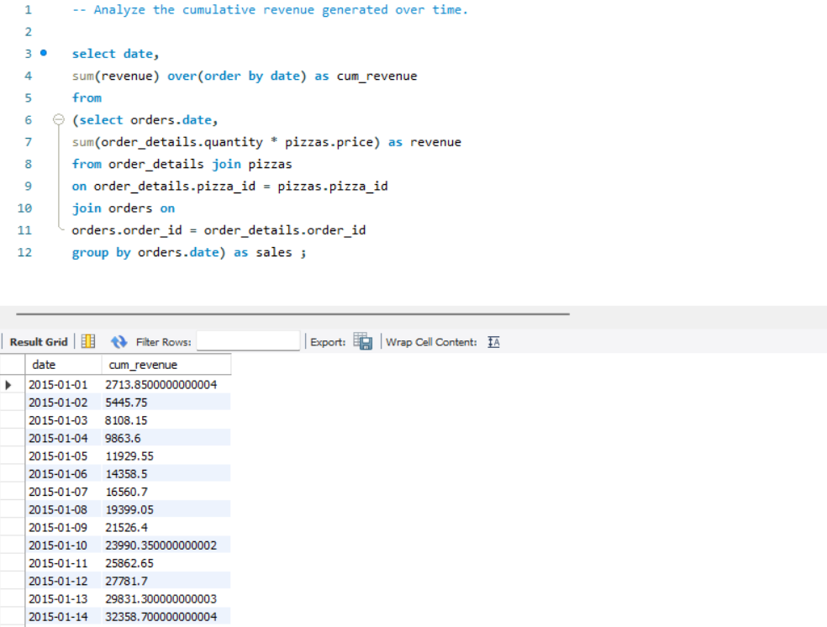

Slide 13
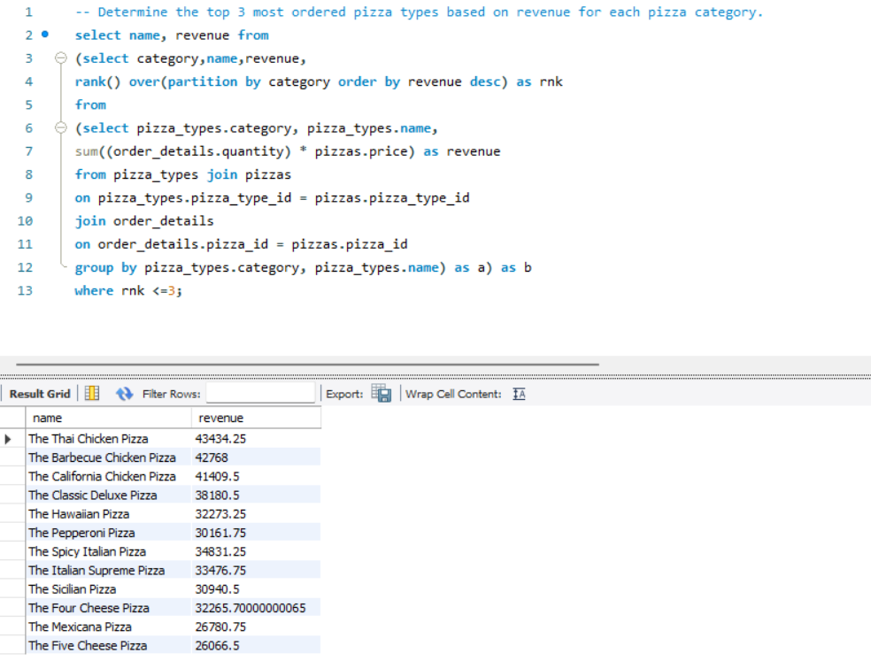

Slide 14
THANK YOU

